Slide 1

Traffic Sign Detection
Section 01 - Group 02

Slide 2
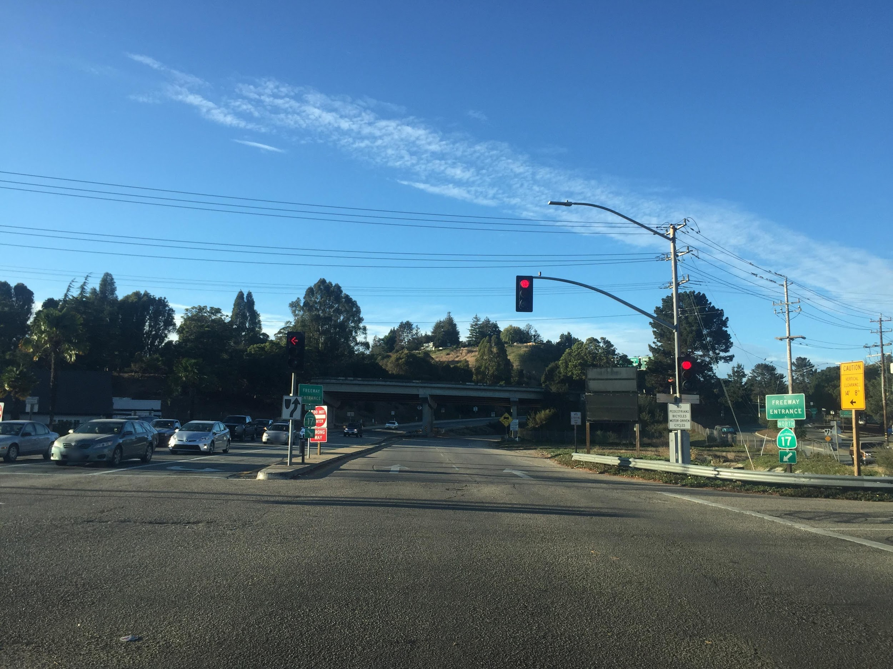

Slide 3
How many signs did you captured?
Maybe 2?
Maybe 3? 4?
There are actually 8 signs in this picture!!!
Lets take a closer look

Slide 4
2
8
4
5
6
7
1
3

Slide 5
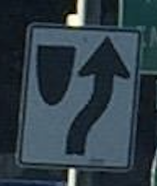
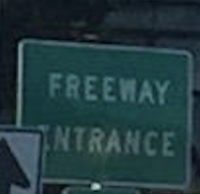
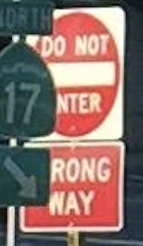
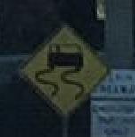
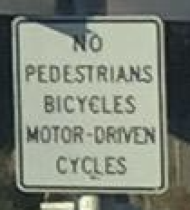
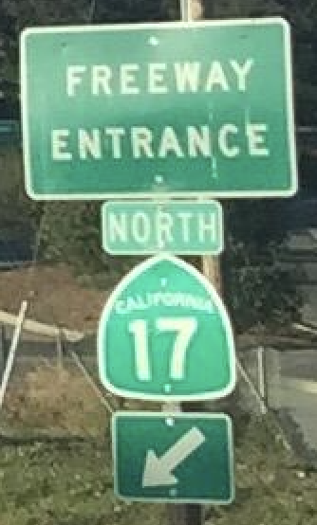
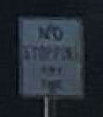
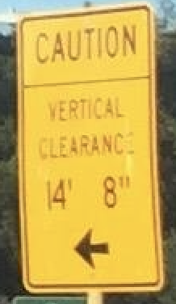

Slide 6
Introduction
Traffic-related accident -> 8th death reason
“Not following the traffic signs” -> one of the leading causes
Goal: Detect traffic signs quickly and accurately

Slide 7
Content
Introduction
Data and Models
Localization Model
Classification Model
Results

Slide 8
Content
Introduction
Data and Models
Localization Model
Classification Model
Results

Slide 9
Data and models
Video Here. Just a placeholder.

Slide 10
Content
Introduction
Data and Models
Localization Model
Classification Model
Results

Slide 11
Content
Introduction
Data and Models
Localization Model
Classification Model
Results

Slide 12





Classification Data Processing
Origin | Cropped

Slide 13



















Classification Data Processing
Compress (level 1) | Compress (level 2) | Compress (level 3)

Slide 14



Classification Data Processing
Origin | Horizontal Flip | Vertical Flip

Slide 15

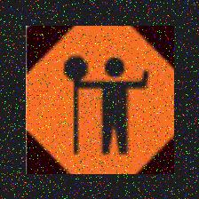
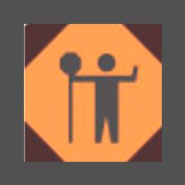

Classification Data Processing
Rotate | Noise | Change Color

Slide 16
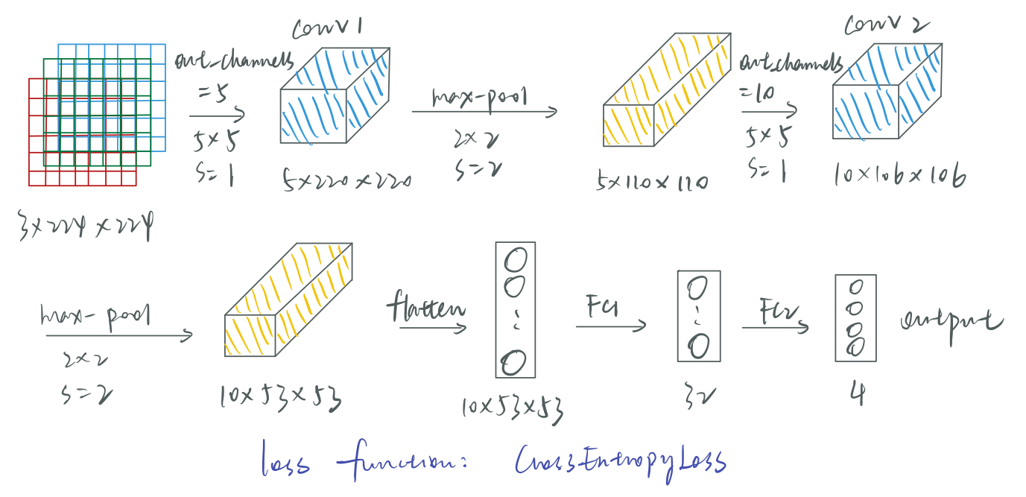
Classification Model

Slide 17
Classification Model
Model params
Batch size = 256
Learning rate = 0.001
Number of epochs = 10

Slide 18
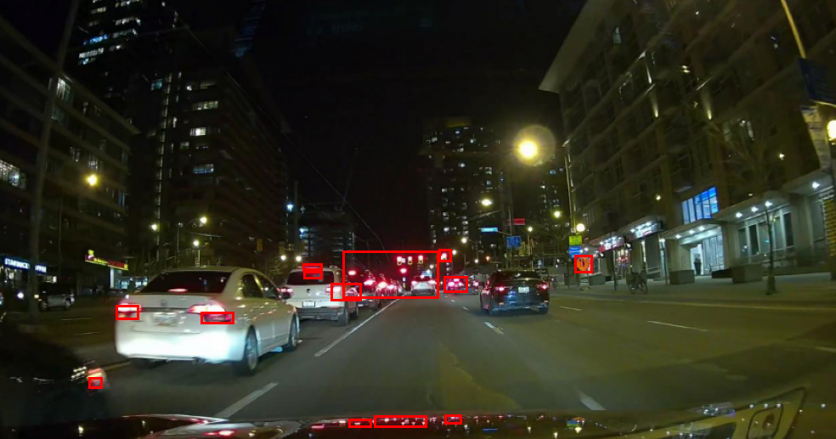
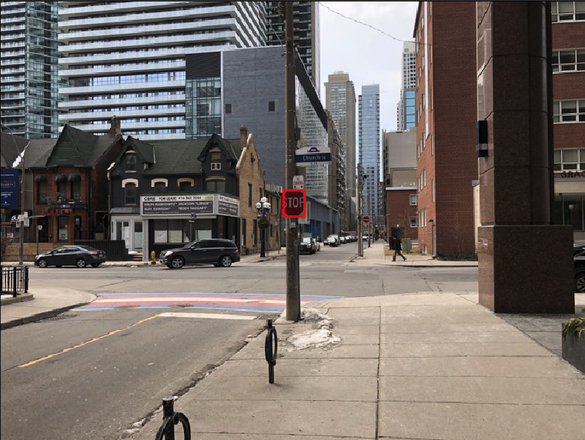
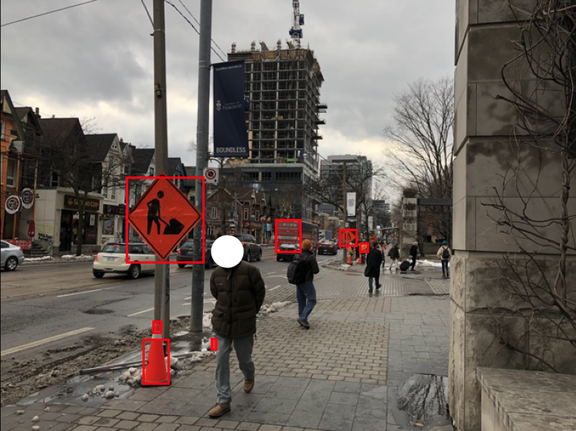
Results - Localization

Slide 19
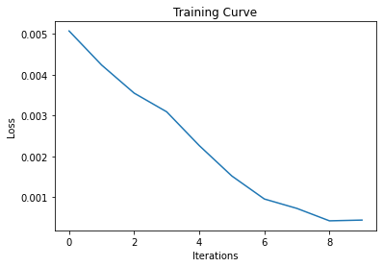
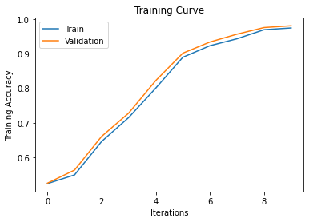
Results - Classification Stage 1 Training Curve

Slide 20
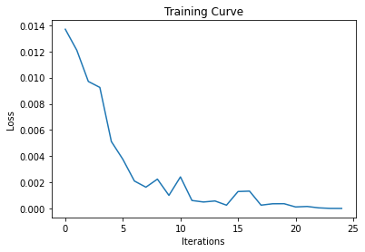
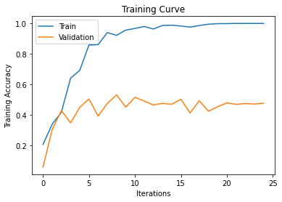
Results - Classification Stage 2 Training Curve

Slide 21
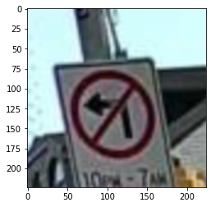
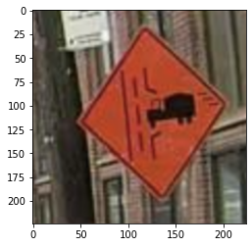
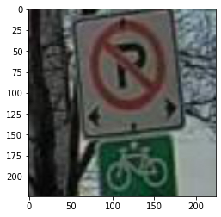
Results - Classification Stage 1 Tests
tensor([-3.7759, 3.1587, -0.6869, -3.1139])
tensor([-0.6687, -1.5104, 1.7822, -1.2634])
tensor([-1.7787, 0.8621, 0.3281, -1.8231])
Probability of being a regulatory sign is 0.98
Probability of being a temporary sign is 0.85
Probability of being a regulatory sign is 0.58

Slide 22
Results - Overall Test Accuracy
around 60%

Slide 23
Thank you for listening!
Take care!

Slide 24
Classification Data Processing - Distribution
 | Enlarge | Compress | Horizontally flip | Vertically filp | Rotation | Noise | Change color
Training dataset stage 1 | 4 | 5+5+9 = 19 | 1 | 1 | 4 | 10 | 9
Validation dataset stage 1 | 4 | 5+5+9 = 19 | 1 | 1 | 2 | 3 | 5
Training dataset stage 2 | 4 | 5+5+9 = 19 | 0 | 1 | 4 | 3 | 9
Validation dataset stage 2 | Real Life Data & data augmentation based on that

Slide 25
Classification Model
Model params
Batch size = 128
Learning rate = 0.002
Number of epochs = 25

Slide 26
Classification Model
Layer | Number of parameters
Convolutional layer 1 | (3*5*5+1)*5 = 380
Convolutional layer 2 | (5*5*5+1)*5 = 1260
Fully connected layer 1 | (10*53*53+1)*32 = 898912
Fully connected layer 2 | (32+1)*4 = 132
Total | 900684

